Slide 1
pH berekenen van basische oplossingen

Slide 2
Zuiver water

Slide 3
Zuiver water: pH = 7,00

Slide 4
Zuiver water: pH = 7,00 bij 298 K

Slide 5
Zuiver water: pH = 7,00
2H₂O → H₃O⁺ + OH⁻

Slide 6
Zuiver water: pH = 7,00
K_{w}
2H₂O → H₃O⁺ + OH⁻

Slide 7
Zuiver water: pH = 7,00
K_{w}
2H₂O → H₃O⁺ + OH⁻
^{1 : 1}

Slide 8
Zuiver water: pH = 7,00
[H₃O⁺] = 1,0 x10⁻⁷
K_{w}
2H₂O → H₃O⁺ + OH⁻
^{1 : 1}

Slide 9
Zuiver water: pH = 7,00
[H₃O⁺] = 1,0 x10⁻⁷ en [OH⁻]= 1,0 x10 ⁻⁷
K_{w}
2H₂O → H₃O⁺ + OH⁻
^{1 : 1}

Slide 10
Zuiver water: pH = 7,00
[H₃O⁺] = 1,0 x10⁻⁷ en [OH⁻]= 1,0 x10 ⁻⁷
K_{w}
2H₂O → H₃O⁺ + OH⁻
^{1 : 1}
K_{w} = [H₃O⁺] . [OH⁻]

Slide 11
Zuiver water: pH = 7,00
[H₃O⁺] = 1,0 x10⁻⁷ en [OH⁻]= 1,0 x10 ⁻⁷
K_{w}
2H₂O → H₃O⁺ + OH⁻
^{1 : 1}
K_{w} = [H₃O⁺] . [OH⁻] = (1,0 x10⁻⁷) . (1,0 x10 ⁻⁷)
= 1,0 x10⁻¹⁴

Slide 12
Zuiver water: pH = 7,00
[H₃O⁺] = 1,0 x10⁻⁷ en [OH⁻]= 1,0 x10 ⁻⁷
K_{w}
2H₂O → H₃O⁺ + OH⁻
^{1 : 1}
K_{w} = [H₃O⁺] . [OH⁻] = (1,0 x10⁻⁷) . (1,0 x10 ⁻⁷)
= 1,0 x10⁻¹⁴
pH + pOH = 14,00

Slide 13
Zuiver water: pH = 7,00
[H₃O⁺] = 1,0 x10⁻⁷ en [OH⁻]= 1,0 x10 ⁻⁷
K_{w}
2H₂O → H₃O⁺ + OH⁻
^{1 : 1}
K_{w} = [H₃O⁺] . [OH⁻] = (1,0 x10⁻⁷) . (1,0 x10 ⁻⁷)
= 1,0 x10⁻¹⁴
pH + pOH = 14,00 bij 298 K

Slide 14
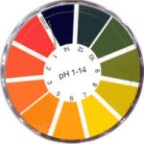
phet
Mijn oplossing en H₃O⁺/OH⁻

Slide 15
De pH berekenen van basische oplossingen

Slide 16
De pH van een 0,50 M natriumhydroxide-oplossing.

Slide 17
De pH van een 0,50 M natriumhydroxide-oplossing.
NaOH $→$ Na⁺ + OH⁻

Slide 18
De pH van een 0,50 M natriumhydroxide-oplossing.
NaOH $→$ Na⁺ + OH⁻
[OH⁻] = 0,50 mol/L

Slide 19
De pH van een 0,50 M natriumhydroxide-oplossing.
[OH⁻] = 0,50 mol/L
pOH = -log 0,50 = 0,30

Slide 20
De pH van een 0,50 M natriumhydroxide-oplossing.
[OH⁻] = 0,50 mol/L
pOH = -log 0,50 = 0,30
pH = 14,00 – 0,30 = 13,70

Slide 21
De pH van een 0,50 M natriumhydroxide-oplossing.
[OH⁻] = 0,50 mol/L
pOH = -log 0,50 = 0,30
pH = 14,00 – 0,30 = 13,70

Slide 22
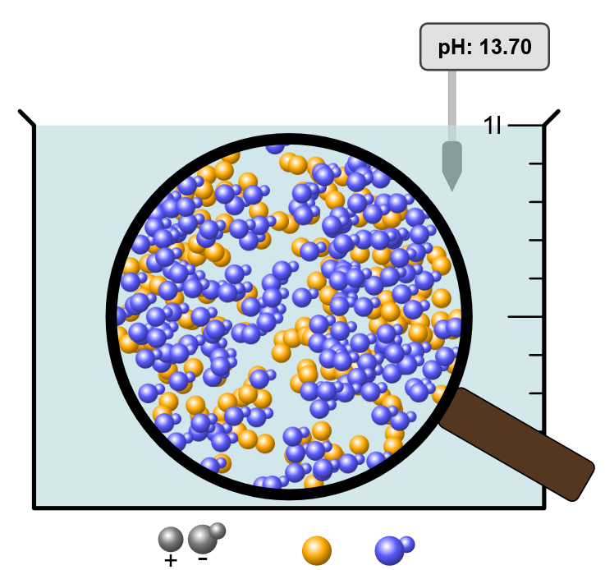
De pH van een 0,50 M natriumhydroxide-oplossing.
NH₃ + H₂O Na⁺ + OH⁻

Slide 23
De pH van een 0,50 M ammoniakoplossing.
(ammonia)

Slide 25
NH₃ + H₂O NH₄⁺ + OH⁻
B: 0,50 mol/L

Slide 26
NH₃ + H₂O NH₄⁺ + OH⁻
B: 0,50 mol/L
O: - X + X + X

Slide 27
NH₃ + H₂O NH₄⁺ + OH⁻
B: 0,50 mol/L
O: - X + X + X
_______________________________________________
E: 0,50 –X X X

Slide 28
NH₃ + H₂O NH₄⁺ + OH⁻
0,50 – X X X

Slide 29
NH₃ + H₂O NH₄⁺ + OH⁻
0,50 – X X X
[NH₄⁺] . [OH⁻]
___________
[NH₃]
K_{b} =
= 1,8 x 10 ⁻⁵

Slide 30
NH₃ + H₂O NH₄⁺ + OH⁻
0,50 – X X X
[NH₄⁺] . [OH⁻]
___________
[NH₃]
K_{b} =
= 1,8 x 10 ⁻⁵
X²
________
0,50 - X
= 1,8 x 10 ⁻⁵

Slide 31
NH₃ + H₂O NH₄⁺ + OH⁻
0,50 – X X X
[NH₄⁺] . [OH⁻]
___________
[NH₃]
K_{b} =
= 1,8 x 10 ⁻⁵
X²
________
0,50 - X
= 1,8 x 10 ⁻⁵

Slide 32
NH₃ + H₂O NH₄⁺ + OH⁻
0,50 – X X X
[NH₄⁺] . [OH⁻]
___________
[NH₃]
K_{b} =
= 1,8 x 10 ⁻⁵
X²
________
0,50 - X
= 1,8 x 10 ⁻⁵
X = 3,000 x 10 ⁻³

Slide 33
NH₃ + H₂O NH₄⁺ + OH⁻
0,50 – X X X
[NH₄⁺] . [OH⁻]
___________
[NH₃]
K_{b} =
= 1,8 x 10 ⁻⁵
X²
________
0,50 - X
= 1,8 x 10 ⁻⁵
X = 3,000 x 10 ⁻³
zonder verwaarlozen
X = 2,991 x 10 ⁻³

Slide 34
NH₃ + H₂O NH₄⁺ + OH⁻
0,50 – X X X
[NH₄⁺] . [OH⁻]
___________
[NH₃]
K_{b} =
= 1,8 x 10 ⁻⁵
X²
________
0,50 - X
= 1,8 x 10 ⁻⁵
X = 3,000 x 10 ⁻³
pOH = 2,52

Slide 35
NH₃ + H₂O NH₄⁺ + OH⁻
0,50 – X X X
[NH₄⁺] . [OH⁻]
___________
[NH₃]
K_{b} =
= 1,8 x 10 ⁻⁵
X²
________
0,50 - X
= 1,8 x 10 ⁻⁵
X = 3,000 x 10 ⁻³
pOH = 2,52 (pOH = 2,52)

Slide 36
NH₃ + H₂O NH₄⁺ + OH⁻
0,50 – X X X
[NH₄⁺] . [OH⁻]
___________
[NH₃]
K_{b} =
= 1,8 x 10 ⁻⁵
X²
________
0,50 - X
= 1,8 x 10 ⁻⁵
X = 3,000 x 10 ⁻³
pOH = 2,52 pH = 11,48

Slide 37
NH₃ + H₂O NH₄⁺ + OH⁻
0,50 – X X X
[NH₄⁺] . [OH⁻]
___________
[NH₃]
K_{b} =
= 1,8 x 10 ⁻⁵
X²
________
0,50 - X
= 1,8 x 10 ⁻⁵
X = 3,000 x 10 ⁻³
pOH = 2,52 pH = 11,48

Slide 38
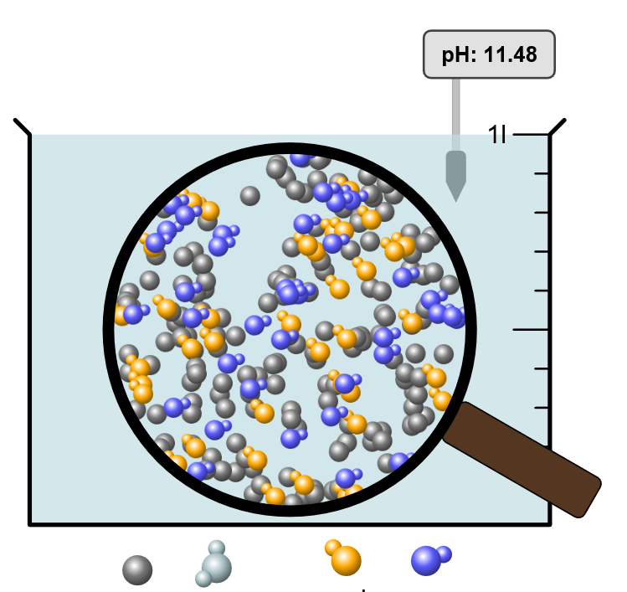
pH van 0,50 M NH₃
NH₃ + H₂O NH₄⁺ + OH⁻
Phet

